Slide 1

Group 8 Presentation
Personal Financial Management
理财，是每个人应该必备的技能
If you don't finance, you will have no finances
Members: 张梓卫 顾翌炜 关卓谦 周诗泽

Slide 2
What’s Wealth Management ?
01
Why Manage it ?
02
Sub-Sections
03

Slide 3

What’s Wealth Management?
Wealth Building
Wealth management is a comprehensive approach that requires us to plan and manage multiple aspects such as income, expenditure, savings, investment, and risk management in order to achieve the goals of wealth appreciation and financial freedom.

Slide 4
Why financial management?
要过上幸福生活，需要多少钱？
住房
支出
孝敬父母
买房＋装修＋物业＝120万
2×500×12月×20年＝24万
家庭用车
住房支出
15万＋1000×12月×10年＝39万
3000×12月×30年＝108万
子女教育
养老支出
出生至大学毕业＝25万
10×3顿×2人×365天×20年＝43.8万

Slide 5
Why financial management?
So Many Factors
1.Retirement pressure increases
2.Reduced social welfare
3.Development of financial markets
4.Personal goal achievement
Reasonably allocating and managing funds can provide more investment opportunities and achieve wealth growth. Even in today's era, the trend of aging population and inflation can become reasons for our financial management.

Slide 6

Sub-Section
1.Continuous development of technology
2.How to save money
3.Mysterious Management Method

Slide 7

PART.01
continuous development of technology
→ Alipay & WeChat Pay

Slide 8



The Wave of Mobile Payments
From
paper currency and credit cards
To
Mobile Payments

Slide 9
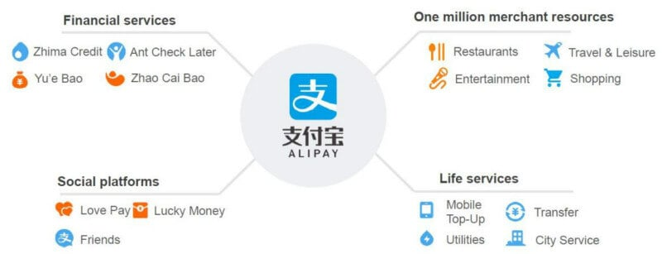
Alipay:
Leading the Digital Finance Frontier
Launched by the Alibaba Group
provides convenient payment features
serves users with a plethora of life services

Slide 10

WeChat Pay:
The Perfect Integration of Social Media and Payments
Seamlessly integrated social and payment functions, it can complete almost all daily transactions in one place
Wechat pay
a comprehensive platform for socializing, shopping, entertainment，etc.
Users can:
send red envelopes, shop, and engage in various interactions

Slide 11

Others about Alipay and WeChat Pay……
5
Globalization of Payments
7
Future Outlook
6
Security and Privacy
8
Conclusion

Slide 12
BUSINESS REPORT
基金知识
理财，是每个人应该必备的技能

Slide 13

目 录 CONTENTS
01
what’s fund?
02
why do we choose fund?
related knowledge
03
pay attention to risks
04

Slide 14
PART.01
Fund

Slide 15
1.1introduction of fund
基金定义
Fund is a type of financial vehicle that collects money from many investors and invests it in a variety of assets, such as stocks, bonds, and other securities. It is a way to diversify investments and reduce risk.

Slide 16
PART.02
why do we choose fund?

Slide 17
1. Diversification: Mutual funds invest in a variety of assets, such as stocks and bonds, effectively reducing risk.
2. Professional management: Mutual funds are managed by professional fund managers, making wiser investment decisions.
3. Convenience: Mutual funds are a simple and convenient way to invest, suitable for investors of all levels.
4. Potential for higher returns: Mutual funds have the opportunity to achieve higher returns than single investments.
赚钱比省钱重要
理财方法随大流
理财=投资
没有合理的预期

Slide 18
PART.03
Related Knowledge

Slide 19
3.1 The Type of Fund
Money Market Fund:The returns of money market funds are usually displayed in terms of ten thousand shares, and their graphs show the yield. The profit principle of money market funds is "interest", which makes them more stable, but the returns are usually the lowest.
Bond Funds:The returns of bond funds are usually displayed in terms of the fund's market value, and their graphs show the changes in market value. The profit principle of bond funds is also "interest", but we usually pay more attention to the changes in the fund's net value, because the share is fixed, and the change in net value determines the return. Therefore, it is more stable and has a higher return, making it a good choice for fund beginners.

Slide 20
3.1 The Type of Fund
Stock Fund:The returns of stock funds are usually represented by the fund's market value, and their graphs show the changes in market value. The profit principle of stock funds is "buy low and sell high". Due to the uncertainty of market value changes, stock funds have greater risks. Although stock funds may bring higher returns, they are not suitable for people who are not proficient in funds to purchase.
Index Fund:The returns of index funds are usually represented by the fund's market value, and their graphs show the changes in market value, which is linked to the index. The profit principle of index funds is also "buy low and sell high". Similarly, the fund has greater risks and may bring higher returns, so it is not suitable for people who are not proficient in funds to purchase.

Slide 21
PART.04
pay attention to risks

Slide 22
RISKS
1.It is important to pay attention to the risk type of the fund. Usually, funds with low and medium-low risk have a very low loss rate and relatively considerable returns, making them more suitable for beginner investors to purchase.
2.Pay attention to the historical returns of the fund, carefully observe whether there are more losses and annualized interest rates.
3.Pay attention to the trading rules of the fund. Some funds have high fees for short-term redemptions and lock-up periods. Make sure to set aside enough emergency funds for yourself.
4.Focus on the fund manager, as an excellent fund manager has a higher probability of achieving profits.

Slide 23
Thanks For Listening
理财，是每个人应该必备的技能

